Slide 1
ING 112A - SPRING 2022 Week 6 UNIT 3 - interpreting data
ASLI ÖZKARA
ITU, ADVANCED ENGLISH PROGRAM

Slide 2
INTERPRETING DATA
Data interpretation is an important part of academic writing.
Statistical data is usually given by charts and graphs.
We need to know
how to interpret
&
how to cite
the information on a chart or graph.

Slide 3
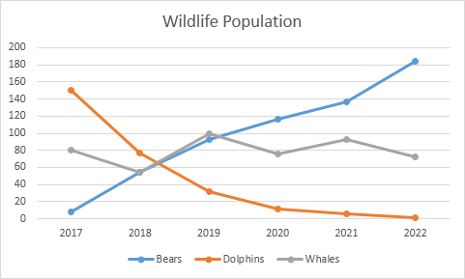
LINE GRAPH
Shows trends
Shows changes of data over time

Slide 4
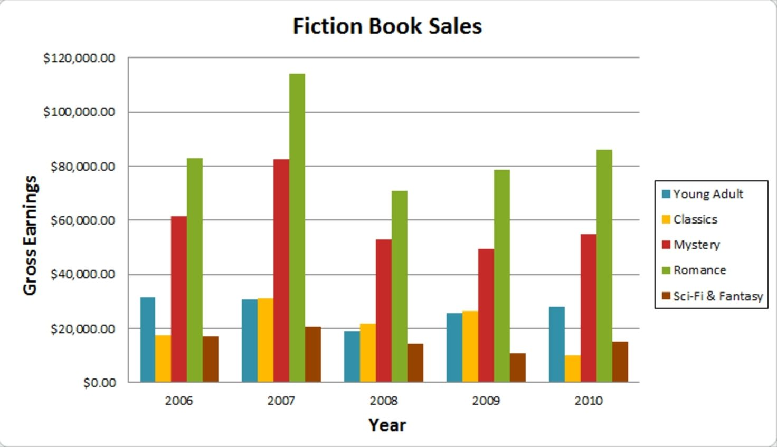
BAR GRAPH
Compares data among categories
The data is independent of each other

Slide 5
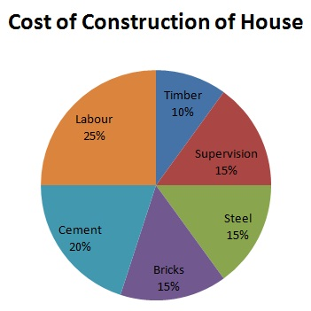
PIE CHART
Compares data among categories
Shows percentages of a whole (100%)
The data is dependent on each other

Slide 6
DESCRIBING TRENDS (p. 52)
Trends are the increases, decreases, or changes over a period of time.
To present trends, generally line graphs and bar graphs are used.
the highest – the lowest data
the biggest – the smallest data
the most – the least data
the stable – the changing data

Slide 7
UPWARD TREND
VERBS
climb – go up – increase – rise
double – triple – boom – jump – soar
peak – reach a peak – reach the highest point
NOUNS
increase – rise – growth – upswing
boom – jump
e.g. The population of bears increased
markedly from about 60 to 100 between
2018 and 2019.
e.g. There has been a rapid growth in the
number of bears since 2017.

Slide 8
DOWNWARD TREND
VERBS
decline – go down – decrease – drop – fall – reduce – dip
collapse – plunge
hit the bottom – reach the lowest point
NOUNS
decline – decrease – downswing
collapse – plunge
e.g. The population of dolphins was
about 150 in 2017, but it will probably
hit the bottom in 2022.
e.g. A collapse in the population of dolphins has been observed.

Slide 9
NO CHANGE in the TREND
VERBS
level out/off – not change – stabilize
maintain the same level – remain stable/steady – stay constant
stop falling/rising
NOUNS
stability – steadiness
e.g. The population of wildlife animals
does not stay constant.
e.g. No steadiness is seen in the number
of whales.

Slide 10
CONTINUOUS CHANGE in the TREND
VERBS
change constantly/continuously
fluctuate – shift up and down
NOUNS
constant change – fluctuation
e.g. The population of whales has
changed constantly since 2017.
e.g. There is a fluctuation in the
number of whales.

Slide 11
ADJECTIVES & ADVERBS to be used (p. 52)
Degree of change
gentle – moderate(ly) – slight(ly) – small – minimal(ly)
dramatic(ally) – marked(ly) – sharp(ly) – significant(ly) – steep(ly)
Speed of change
gradual(ly) – slow(ly) – steadi(ly)
quick(ly) – rapid(ly) – sudden(ly) – swift(ly)
e.g. There has been a rapid growth in the number of bears since 2017.
e.g. The population of bears increased markedly from about 60 to 100 between 2018 and 2019.

Slide 12
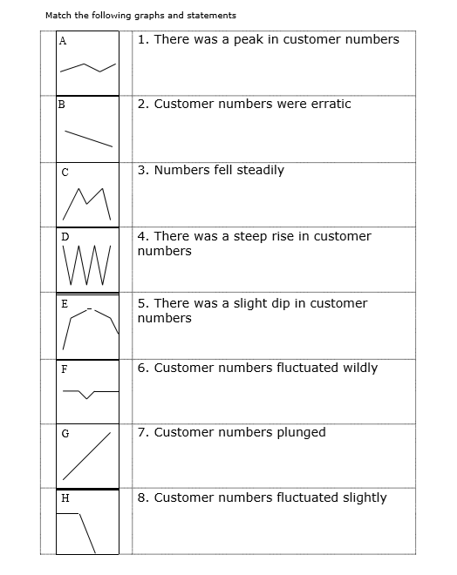
exercise 2

Slide 13
MAKING COMPARISONS
We use comparisons to show similarities & differences.
To present comparisons, generally bar graphs and pie charts are used.
similar / dissimilar values
equal values
percentages
proportions

Slide 14
ADJECTIVES/ADVERBS used in COMPARISONS (p. 56)
COMPARATIVES
far/significantly more than – twice/three times more than
far/significantly less than - twice/three times less than
more/less than half/a third/10 percent
SUPERLATIVES
the highest – the lowest – the largest – the smallest
the most/the least amount/number/percentage of
AS
as high/low/small/large/much/many as
RATIOS
the majority/minority of – 10 percent of – one third of – a quarter of – half of

Slide 15
Labour cost accounts for
a quarter of the total expense.
The money spent for steel is
as much as the supervision cost.
Romance book sales have always
comprised the highest
gross earning.
In 2007, the gross earning
from the sales of classics was
nearly three times more compared
to 2010.

Slide 16
Cement cost doubled the Timber in the construction of the house
The highest sale of romance books was in 2007.
The sales of Romance books peaked in 2007 with more than 100.000 dollars gross earning.
cost of timber is half of the cost of cement
sci-fi book sales have always been lower than other fiction books
In construction of house, the cost percentage of supervision is the same as steel and bricks.
There was a peak in book sales in 2007 across all fiction categories.
It has been observed that the income from young adult books’ sales and classics books’ sales are nearly equal in 2007 and 2009 with about 30.000 dollars and 25.000 dollars gross earning respectively
In 2007 the gross earnings of classics and young adult books are almost the same
Sales of Sci-fci books were mostly stable between the years of 2006 and 2010
The sales of classic books fluctuated slightly between 2006 and 2009.
The amount of money earned from Classics sales were the lowest in 2010
Except for 2007 the gross earnings of sci-fi & fantasy books are always less than 20,000 dollars.
Total earnings from classical books has been halved from last year
romance books were the best selling category every year between 2016 and 2010
Cost of labour occupies a quarter of the construction cost.
The gross earnings of romance books were the highest in 2007
romance book sales fluctuated slightly between 2006 and 2010
Sales of young adult and romance books increased between 2008 and 2010 compared to previous years

Slide 17

The end ..

